Slide 1
Convolutional Neural Networks
By Dr. Ali Saeed

Slide 2
CNN
It is most useful for image classification
It can also be deployed for other NN
CNN has hidden layers called Convolutional Layes
CNN can also contains Non-Convolutional layers but mainly it contains convolutional layers
CNN receive input and transform it to the next layer
Convolutional layers detect patterns from the images

Slide 3
CNN
With each convolutional layer we should decide how many number of layers it should have?
These filters actually detect the patterns
Patterns / Filters:
  Shapes
  Edges (Edge Dectector)
  Texture
  Objects

Slide 4
CNN
These filer detect the edges
Following two operations CNN performs on the input images:
  Kernel Size Convolve
  Max Pooling

Slide 5
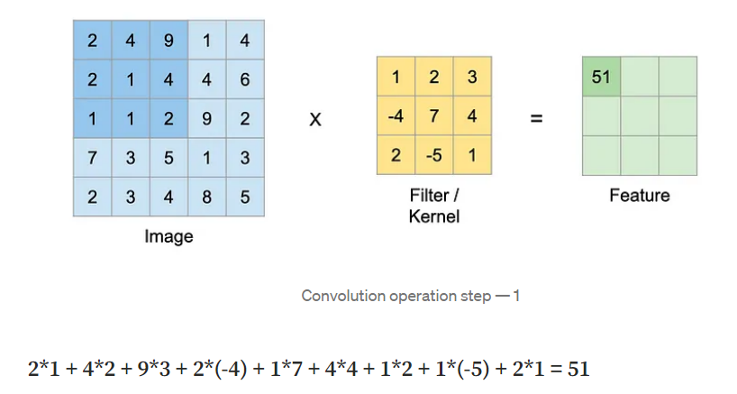
Convolution Layer – Step 1

Slide 6
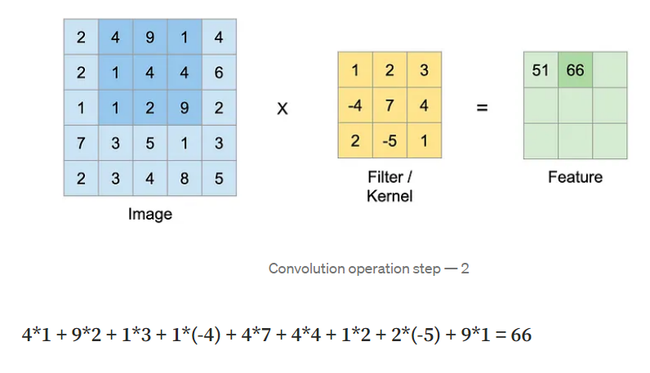
Convolution Layer – Step 2

Slide 7
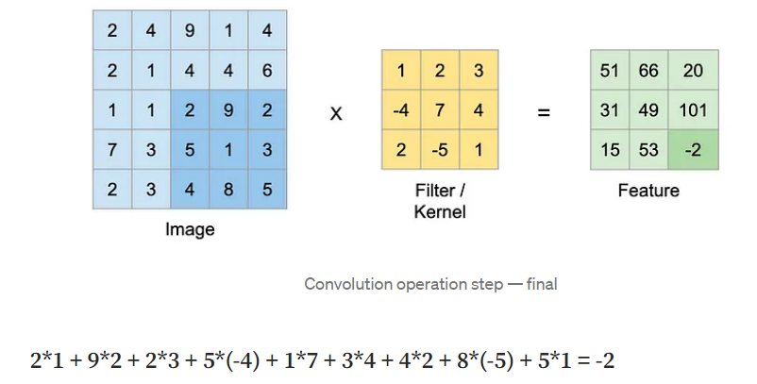
Convolution Layer – Step final

Slide 8
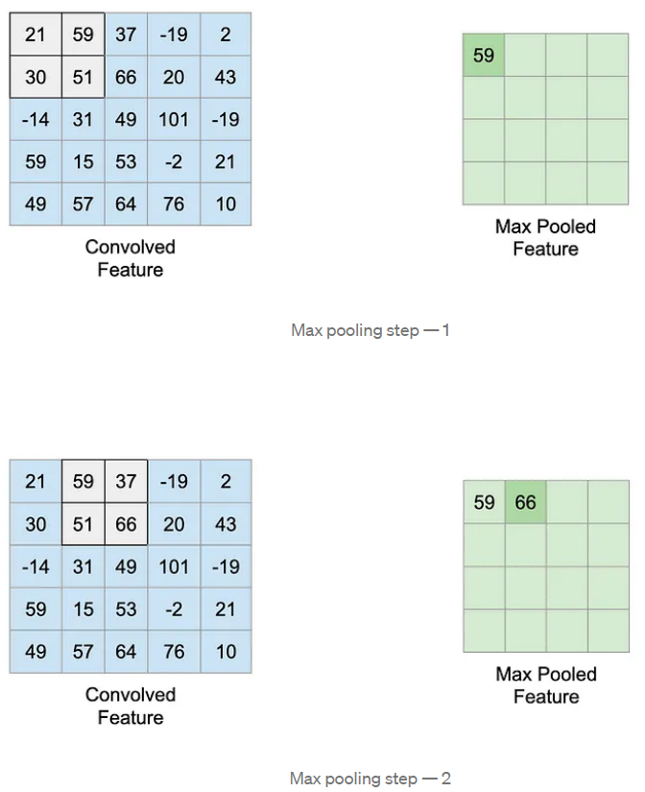
Max Pooling

Slide 9
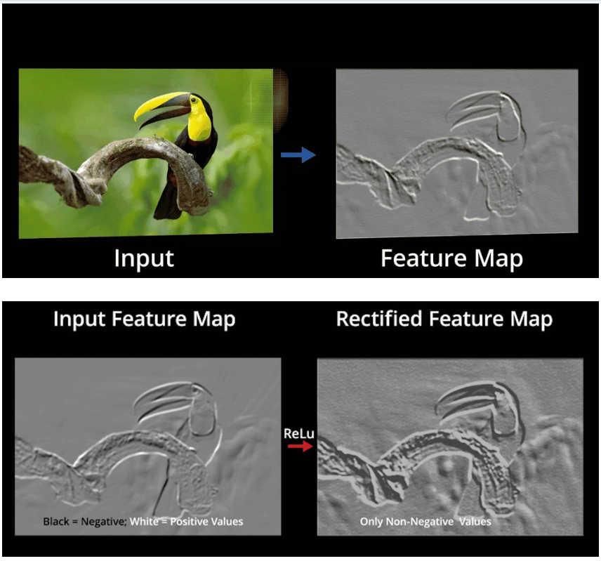
Results of CNN Operations

Slide 10
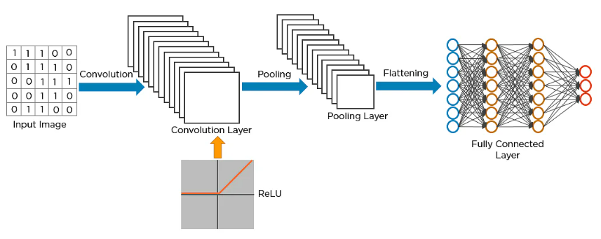
CNN Network Example
Flattening is used to convert all the resultant 2-Dimensional arrays from pooled feature maps into a
single long continuous linear vector. The flattened matrix is fed as input to the fully connected layer
to classify the image.

Slide 11
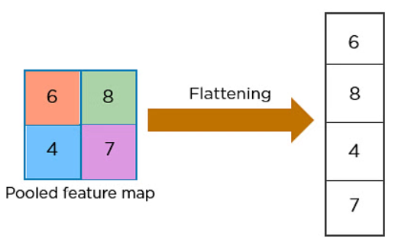
Flatten Operation on CNN
Main contribution of Flatten is Converts 3D / 2D tensor into 1D vector
The flattened matrix is fed as input to the fully connected layer to classify the image.

Slide 12
Thanks

